Slide 1

Scam and Phishing Awareness
Develop ICT Solution
IRNANDI MULIAWAN
18073

Slide 2
What is Phishing?
Phishing email messages, websites, and phone calls are designed to steal money or sensitive information. Cybercriminals can do this by installing malicious software on your computer, tricking you into giving them sensitive information, or outright stealing personal information off of your computer.

Slide 3
Types of Phishing Attacks
Social Engineering - On your Facebook profile or LinkedIn profile, you can find: Name, Date of Birth, Location, Workplace, Interests, Hobbies, Skills, your Relationship Status, Telephone Number, Email Address and Favorite Food. This is everything a Cybercriminal needs in order to fool you into thinking that the message or email is legitimate.
Link Manipulation - Most methods of phishing use some form of deception designed to make a link in an email appear to belong to the spoofed organization or person. Misspelled URLs or the use of subdomains are common tricks used by phishers. Many email clients or web browsers will show previews of where a link will take the user in the bottom left of the screen or while hovering the mouse cursor over a link.
Spear phishing - Phishing attempts directed at specific individuals or companies have been termed spear phishing. Attackers may gather personal information (social engineering) about their targets to increase their probability of success. This technique is, by far, the most successful on the internet today, accounting for 91% of attacks.
Clone phishing - A type of phishing attack whereby a legitimate, and previously delivered email containing an attachment or link has had its content and recipient address(es) taken and used to create an almost identical or cloned email. The attachment or link within the email is replaced with a malicious version and then sent from an email address spoofed to appear to come from the original sender.
Voice Phishing - Voice phishing is the criminal practice of using social engineering over the telephone system to gain access to personal and financial information from the public for the purpose of financial reward. Sometimes referred to as 'vishing’, Voice phishing is typically used to steal credit card numbers or other information used in identity theft schemes from individuals.

Slide 4
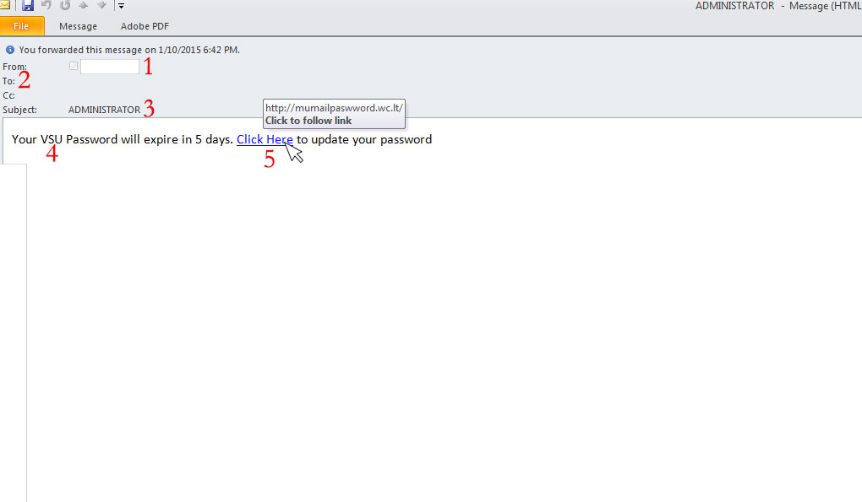
Examples of Phishing Attacks
Spear Phishing
The first question you have to ask is, “Do I know this person?” or “Am I expecting an email from the person?” If you answered no to either question, you must take a harder look at other aspects of the email
A large amount of phishing emails will blank out the To: or Cc: fields so that you cannot see that this is a mass email to a large group of people.
Phishing emails will often come with subjects that are in all capitals or have multiple exclamation marks in order for you to think that this email is important or that you should take the recommended action within the email.
This is a targeted email (Spear Phishing) to VSU, so more than likely, this was sent to everyone at VSU that the sender had in their address book.
Hovering your mouse over the link, you can see that this is not taking you to a valdosta.edu address, but rather to an external site. This site would either prompt you for a password, then steal that password, or would download a malicious file infecting your computer.

Slide 5
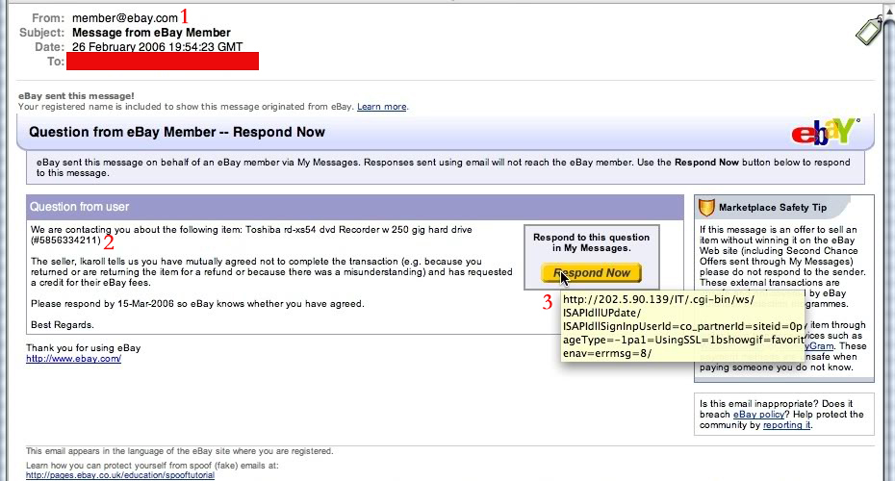
Examples of Phishing Attacks
Clone Phishing
These emails are harder to spot because they look exactly like legitimate emails you would normally receive. The first cue that something is not right with this email is the sender. It is a generic address, member@ebay.com. You would never see this from a legitimate email, you would see the username of the buyer/seller; e.g.; valdostarocks@ebay.com
The question you have to ask yourself is did I buy anything from ebay recently, and if I did, is this what I purchased? If no to these questions, then you more than likely have a phishing email.
The last piece is the most critical in seeing if the email is in fact a phishing email. If you hover your mouse over the button it is wanting you to press, you see that this is not taking you to an ebay.com site, but rather an external site that will more than likely try to steal your ebay credentials.

Slide 6
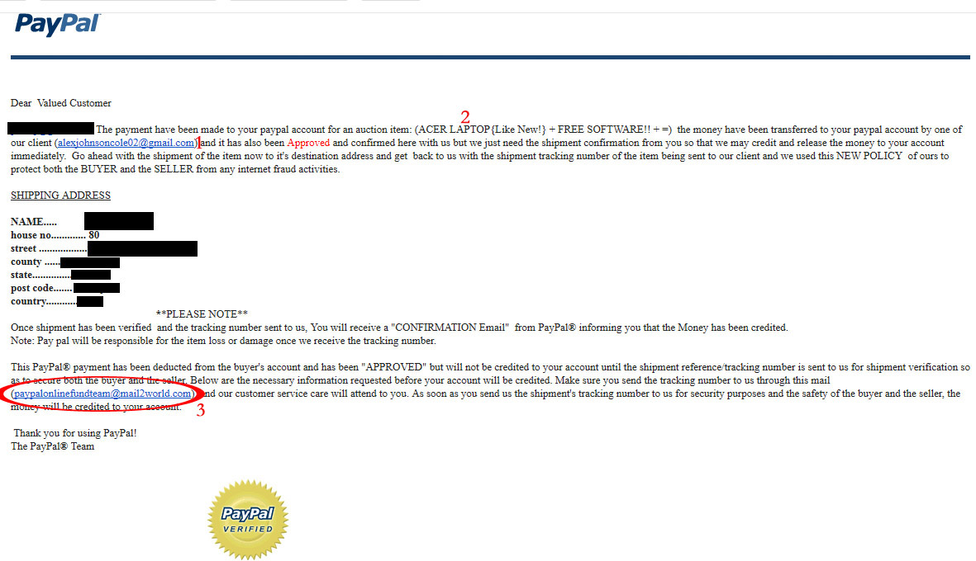
Examples of Phishing Attacks
Clone Phishing
Just like in the previous example, this email looks like a legit PayPal email that you would normally see. So the first thing to do is to see if you recognize the email, or if you have done any kind of transaction with this email address. Also look through the email for spelling and grammatical errors, as Cybercriminals will often leave these errors in the body of the email.
Second, see if the item in question is one that you actually bought or sold. If not, then delete and move on.
Look at the email circled, if this was an official email from paypal, it would end in “@paypal.com” not mail2world.

Slide 7
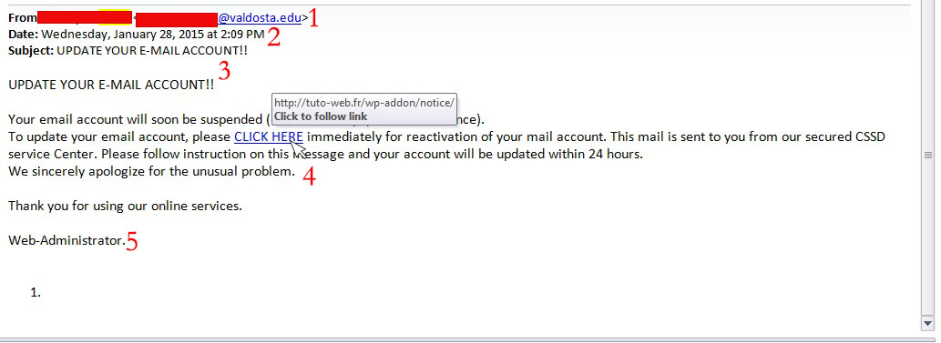
Examples of Phishing Attacks
Link manipulation
This is actually from a valdosta.edu address, so first you have to ask whether or not this is from someone you know or someone that would be emailing you about your email account. Remember that only members of I.T. will email you about your accounts.
One again, cybercriminals will use a subject line trying to get your attention, often using all caps and multiple exclamation marks. A legitimate email from I.T. will not do this.
The To: and Cc: lines are not shown so that you can’t tell this is a mass email targeting multiple individuals.
Hovering your mouse over the link, you can see that this is not a legitimate valdosta.edu link, but an external one designed to steal your information or install malicious software.
The signature often will end in a generic sign off as to not arouse suspicion as to the sender.

Slide 8
Tips to protect yourself from Phishing emails.
I.T. will NEVER ask for your password over email. Please be wary of any emails asking for passwords. Never send passwords, bank account numbers, or other private information in an email.
Be cautious about opening attachments and downloading files from emails, regardless of who sent them. These files can contain viruses or other malware that can weaken your computer's security. If you are not expecting an email with an attachment from someone, such as a fax or a PDF, please call and ask them if they indeed sent the email. If not, let them know they are sending out Phishing emails and need to change their email password immediately.
Never enter private or personal information into a popup window.
If there is a link in an email, use your mouse to hover over that link to see if it is sending you to where it claims to be, this can thwart many phishing attempts.
Look for 'https://' and a lock icon in the address bar before entering any private information on a website.
Look for spelling and bad grammar. Cybercriminals are not known for their grammar and spelling. Professional companies or organizations usually have staff that will not allow a mass email like this to go out to its users. If you notice mistakes in an email, it might be a scam.

Slide 9
What to do when you think you received a phishing email.
First, do not click on any links within the email or download any attachment. Forward the email to abuse@valdosta.edu for Information Security to examine and determine if legitimate.
If there is an attachment in the email, and you recognize the sender but aren't expecting an attachment from them, please call them and ask if it is legitimate.

Slide 10
THANK YOU!!
Source :
Chad Vantine
Valdosta State University

